Slide 1

Influential Observation Analysis

Slide 2
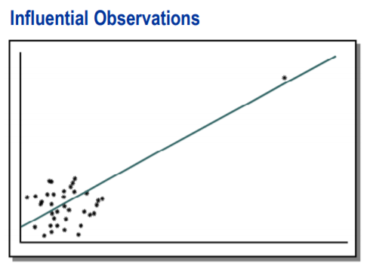
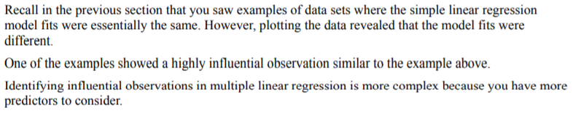
Influential Observation Analysis

Slide 3
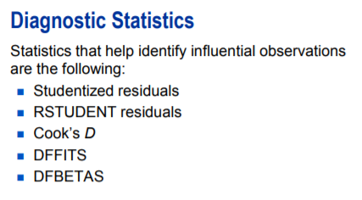
Influential Observation Analysis

Slide 4
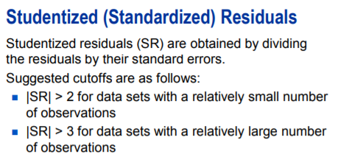
Influential Observation Analysis

Slide 5
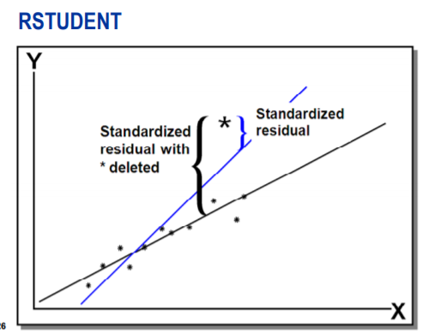
Influential Observation Analysis
RSTUDENT residuals are similar to the standardized residuals except that they are calculated after deleting the ith observation. In other words, RSTUDENT residual is the difference between observed Y and the predicted values of Y excluding this observation from the regression.

Slide 6
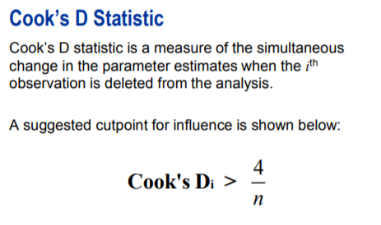
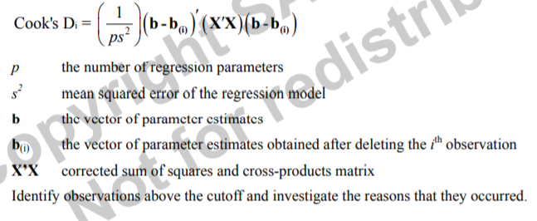
Influential Observation Analysis

Slide 7
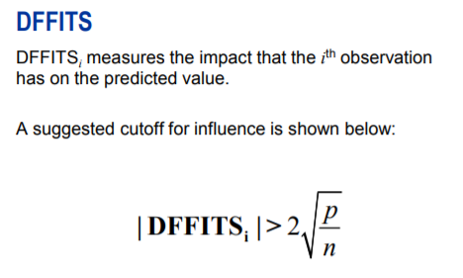
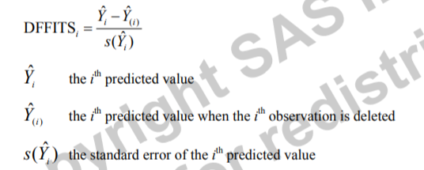
Influential Observation Analysis

Slide 8
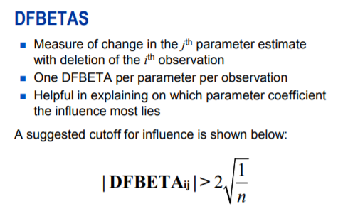
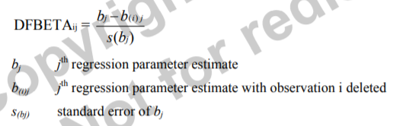
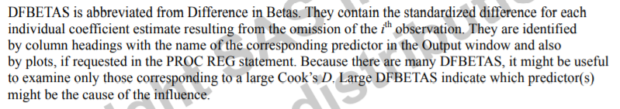
Influential Observation Analysis

Slide 9

DEMO

Slide 10
Q&A

